Slide 1
Shortest Path Algorithm
Graph
By Abdan Hafidz
Teori Graf RKA

Slide 2
Dijkstra’s
2
2
D
A
9
B
11
3
5
1
E
C
7
Berapa biaya tol minimum dari kota A ke kota E?
(Ya ya ya kita tahu jawabannya 9)
Teori Graf RKA

Slide 3
Heapq
Dijkstra’s
2
dist = 2
dist = inf
By Distance
dist = 0
D
D
A
2
A
9
dist = 4
dist = 9
dist = inf
B
11
B
3
B
5
Dist from A to x = dist[x]
dist[A] = 0
dist[B] = inf
dist[C] = inf
dist[D] = inf
dist[E] = inf
1
4
2 + 2 < 9 !
E
9
E
E
3 + 1 = 4
C
C
3
4 + 1 > 3
(Don’t need to push)
7
dist = inf
dist = 10
dist = 13
dist = inf
2
dist = 3
0
2
2
4
3
curr_dist =
2
10
9
2 + 11
13
3 + 7 < 13
4 + 5 < 10
At the end we wouldn’t need to push the node anymore so the heapq will be empty and algorithm finish!
Teori Graf RKA

Slide 4
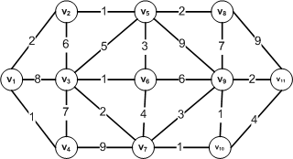
Bellman-Ford’s Algorithm
Set initial distance to zero for the source vertex, and set initial distances to infinity for all other vertices.
For each edge, check if a shorter distance can be calculated, and update the distance if the calculated distance is shorter.
Check all edges (step 2) V−1 times. This is as many times as there are vertices (V), minus one.
Optional: Check for negative cycles. This will be explained in better detail later.

Slide 5
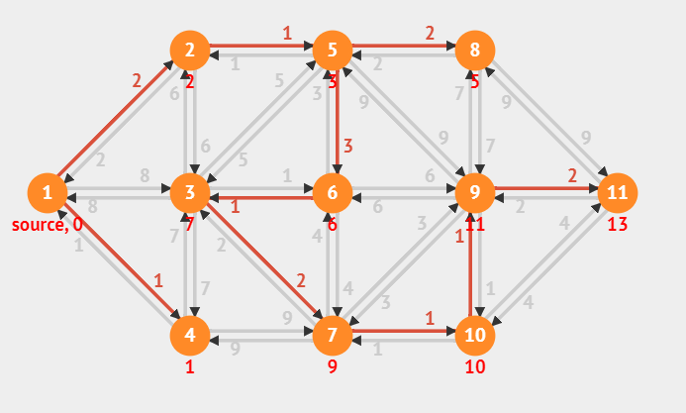



d[v1] = 0
d[v2 … v11] = $∞$
Bellman-Ford’s Algorithm
d[1] + c[v1,v2] < d[2] = 0 + 2 < $∞→$ d[2] = 2
d[1] + c[v1,v3] < d[3] = 0 + 8 < $∞→$ d[3] = 8
d[1] + c[v1,v4] < d[4] = 0 + 1 < $∞→$ d[4] = 1
d[2] + c[v2,v5] < d[5] = 2 + 2 < $∞→$ d[2] = 4
d[2] + c[v2,v3] < d[3] = 2 + 6 < $∞→$ d[3] = 8
…..
Repeat the iteration for every v : (V – 1) times, it will construct
for the answer is 14

Slide 6
A* Search Algorithm
The A* algorithm is implemented in a similar way to Dijkstra’s algorithm. Given a weighted graph with non-negative edge weights, to find the lowest-cost path from a start node S to a goal node G, two lists are used:
An open list, implemented as a priority queue, which stores the next nodes to be explored. Because this is a priority queue, the most promising candidate node (the one with the lowest value from the evaluation function) is always at the top. Initially, the only node in this list is the start node S.
A closed list which stores the nodes that have already been evaluated. When a node is in the closed list, it means that the lowest-cost path to that node has been found.
To find the lowest cost path, a search tree is constructed in the following way:
Initialize a tree with the root node being the start node V1.
Remove the top node from the open list for exploration.
Add the current node to the closed list.
Add all nodes that have an incoming edge from the current node as child nodes in the tree.
Update the lowest cost to reach the child node.
Compute the evaluation function for every child node and add them to the open list.
Just like in Dijkstra’s algorithm, the lowest cost is updated as the algorithm progresses in the following way:

Slide 7
A* Search Algorithm
We have to determine a Heuristic function [h(n)] that can have random values ​​with rules
The number is always below the distance between that point and the goal
h(v1) = 3
h(v2) = 3
h(v3) = 4
h(v4) = 5
h(v5) = 5
h(v6) = 7
h(v7) = 7
h(v8) = 1
h(v9) = 1
h(v10) = 3
h(v11) = 1
from the start node we will use the following formula:
startnode to nextnode = F(n) = g(n)+h(n)

Slide 8
from the start node we will use the following formula: startnode to nextnode = f(vn) = cost(vn)+h(vn)
f(v4) = 1 + 5 = 6
f(v3) = 8 + 4 = 12
f(v2) = 2 + 3 = 5
From v2 to next node
f(v5) = 1 + 5 = 6
f(v3) = 6 + 4 = 10
From v5 to next node
f(v3) = 5 + 4 = 9
F(v6) = 3 + 7 = 10
F(v9) = 9 + 1 = 10
From v3 to next node
f(v6) = 1 + 7 = 8
F(v7) = 2 + 7 = 9
A* Search Algorithm

Slide 9
A* Search Algorithm
from the start node we will use the following formula: startnode to nextnode = f(vn) = cost(vn)+h(vn)
From v6 to next node
f(v9) = 6 + 1 = 7
f(v7) = 4 + 7 = 11
From v9 to next node
f(v11) = 2 + 1 = 3
f(v8) = 7 + 1 = 11
f(v10) = 1 + 3 = 4
So we can identify that the routes are :
V1 – V2 – V5 – V3 – V6 – V9 – V11 = 2 + 1 + 2 + 7 + 2 = 14

Slide 10
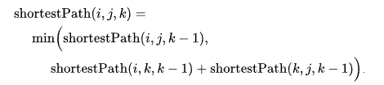
Floyd-Warshall’s Algorithm
Suppose we have a graph G[][] with V vertices from 1 to N. Now we have to evaluate a shortestPathMatrix[][] where shortestPathMatrix[i][j] represents the shortest path between vertices i and j.
Obviously the shortest path between i to j will have some k number of intermediate nodes. The idea behind floyd warshall algorithm is to treat each and every vertex from 1 to N as an intermediate node one by one.
The following figure shows the above optimal substructure property in floyd warshall algorithm:
Initialize the solution matrix same as the input graph matrix as a first step.
Then update the solution matrix by considering all vertices as an intermediate vertex.
The idea is to pick all vertices one by one and updates all shortest paths which include the picked vertex as an intermediate vertex in the shortest path.
When we pick vertex number k as an intermediate vertex, we already have considered vertices {0, 1, 2, .. k-1} as intermediate vertices.
For every pair (i, j) of the source and destination vertices respectively, there are two possible cases.
k is not an intermediate vertex in shortest path from i to j. We keep the value of dist[i][j] as it is.
k is an intermediate vertex in shortest path from i to j. We update the value of dist[i][j] as dist[i][k] + dist[k][j], if dist[i][j] > dist[i][k] + dist[k][j]

Slide 11
k = 0
V1 – V2 = 1
V1 – V3 = 8
V1 – V4 = 1
V2 – V3 = 6
V2 – V5 = 1
V3 – V2 = 6
V3 – V4 = 7
…..
We will find the minimum cost from the pair above is generally V1 – V2.
k = 1
V1 – V2 – V5 = 2 + 1 = 3
V1 – V2 – V3 = 2 + 6 = 8
k = 2
V1 – V2 – V5 – V8 = 3 + 2 = 5
V1 – V2 – V5 – V3 = 3 + 5 = 8
V1 – V2 – V5 – V6 = 3 + 2 = 5
V1 – V2 – V5 – V9 = 3 + 2 = 5
Floyd-Warshall’s Algorithm
k = 3
V1 – V2 – V5 – V8 – V9 = 5 + 7 = 12
V1 – V2 – V5 – V8 – V11 = 5 + 9 = 14
k = 4
V1 – V2 – V5 – V8 – V9 – V11 = 12 + 2 = 14

Slide 12
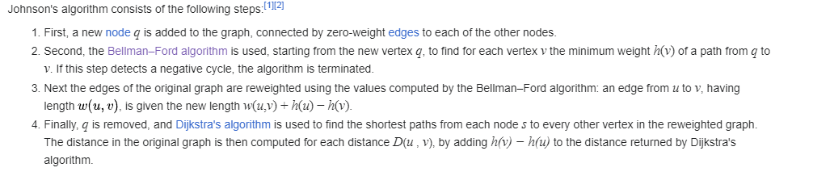
Johnson’s Algorithm
Because the graph does not have negative weights,
it works the same as the Djikstra method

